Slide 1

SEGMENTATION AND RECOGNITION OF INFORMATION PRINTED ON ID CARDS
MADHANA GOPALAPURAM RAMESH RATHISH AADIRAJA

Slide 2
what, why, who
In simple it is an ID card OCR machine
Remote automatic verification systems
Banking, E-Commerce, Financial Technologies

Slide 3
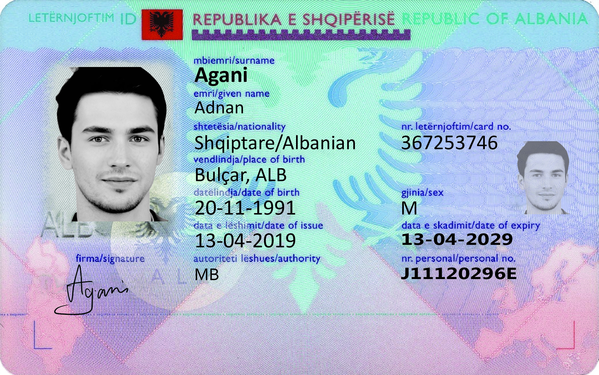
dataset
Unlike the datasets for cats and dogs or cars the dataset for ID cards are scant
MIDV-2020: A Comprehensive Benchmark Dataset for Identity Document Analysis
Unique text field values and unique artificially generated faces

Slide 4
approaching the Problem
Segmentation of id card from original image
Recognition of information printed on the segmented id card

Slide 5
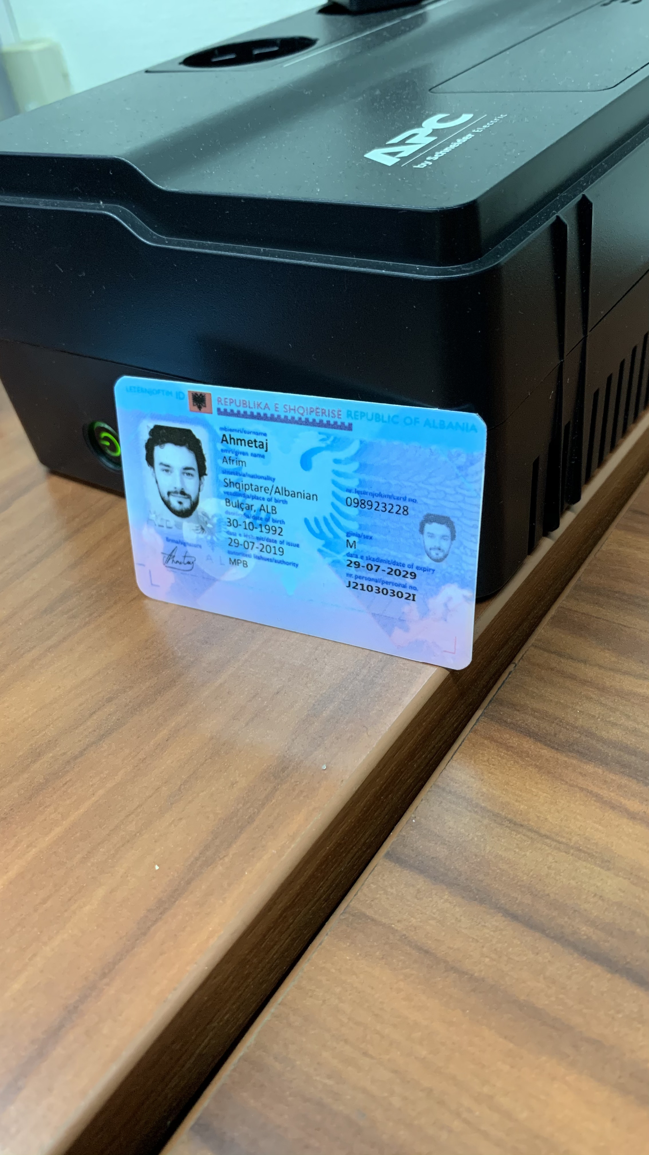
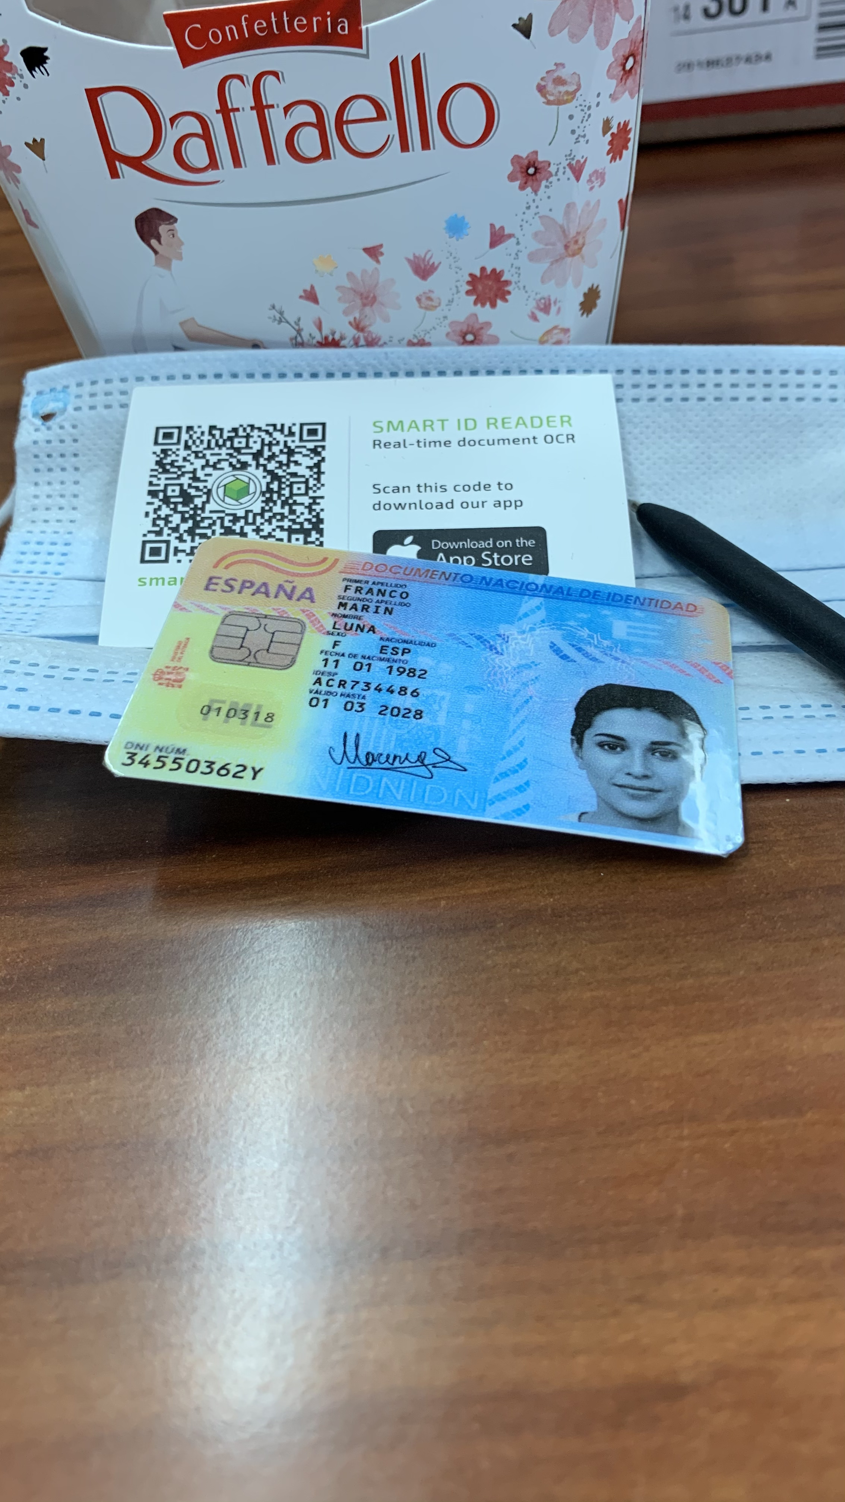
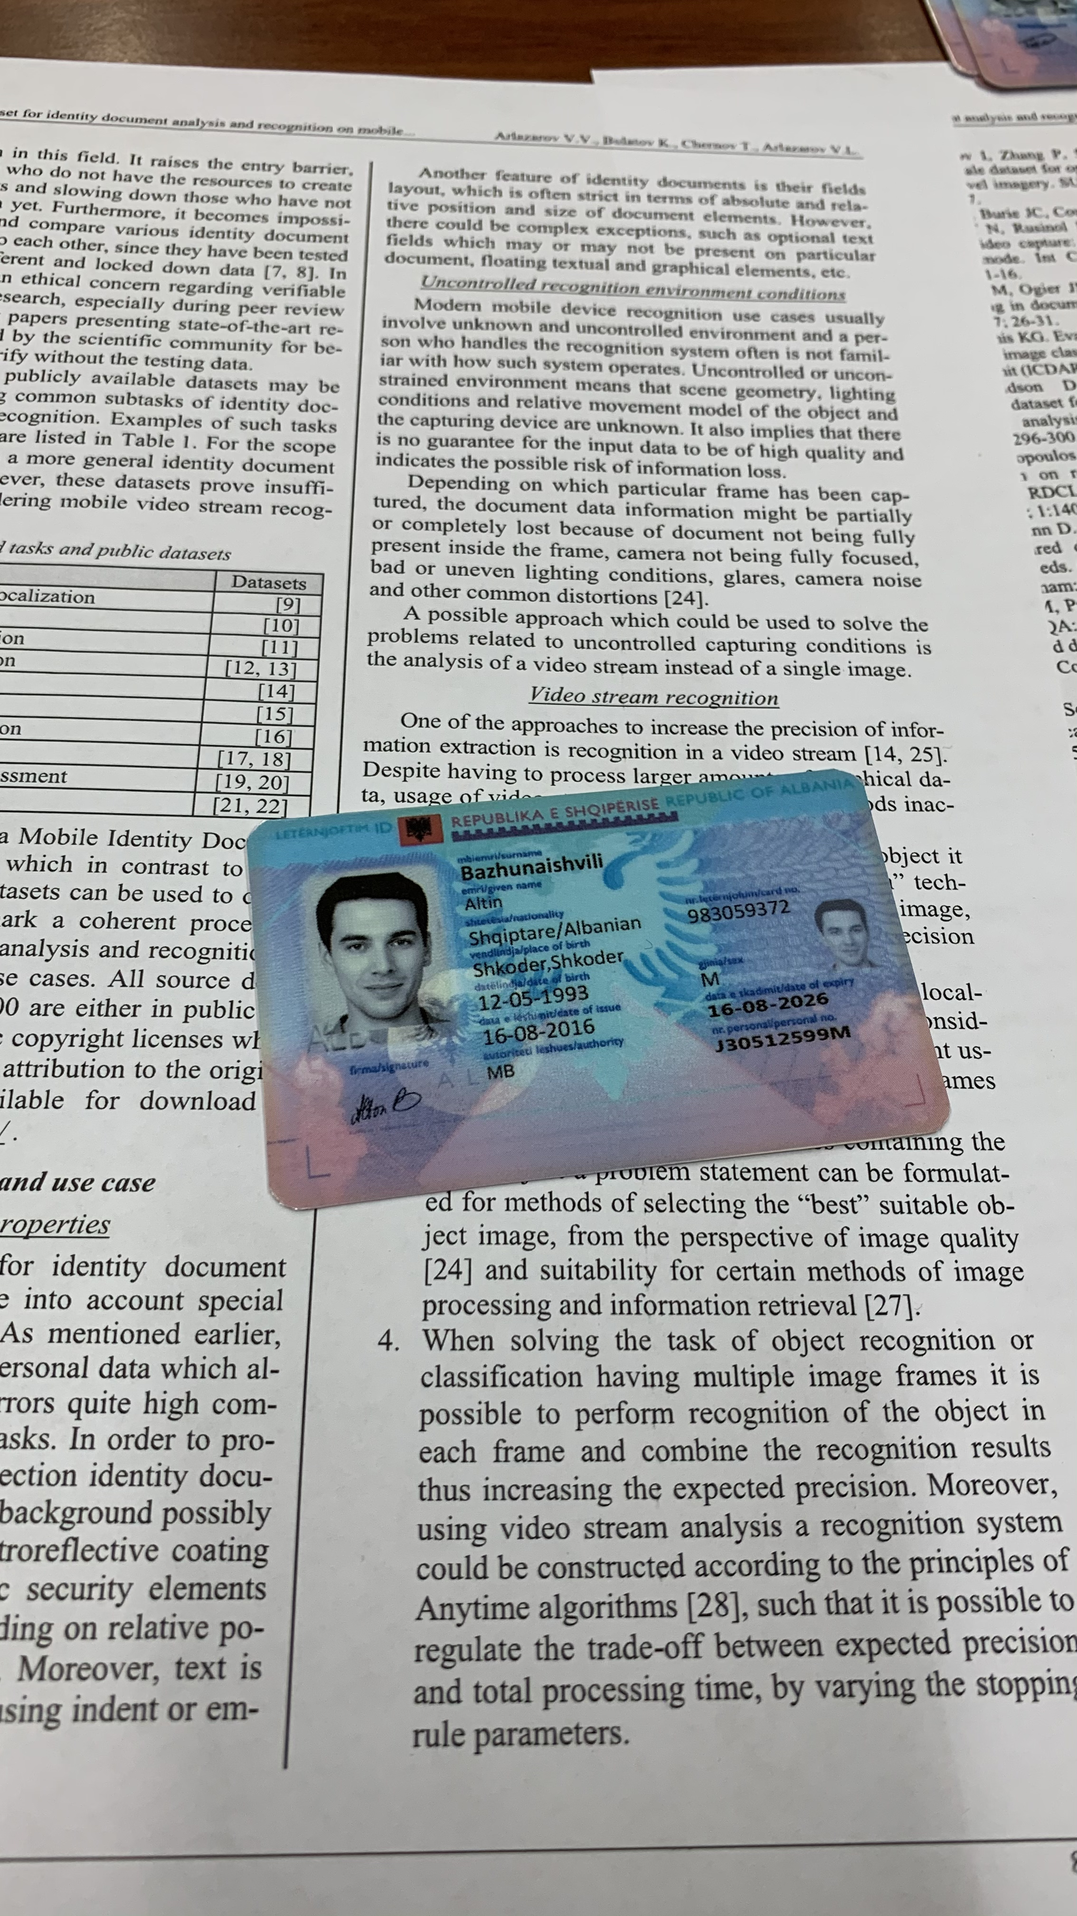
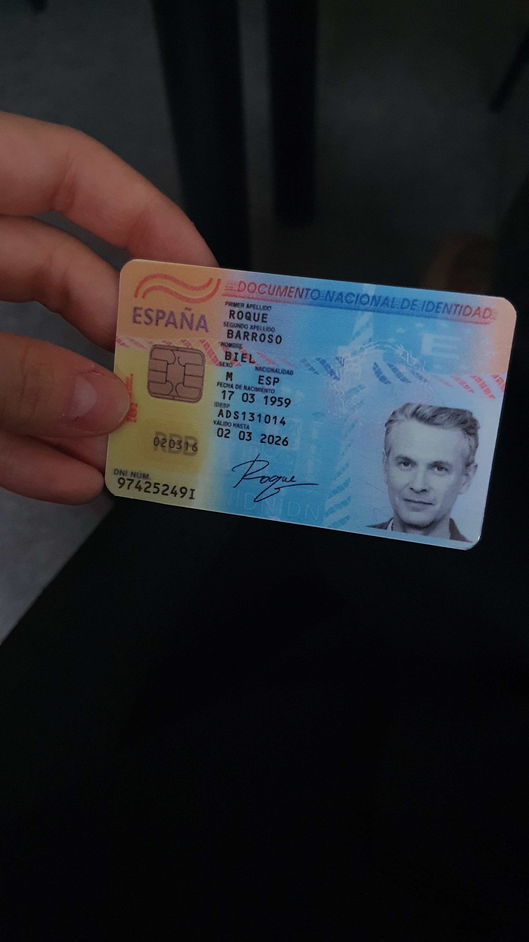
Example images

Slide 6
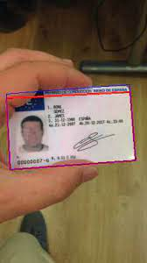
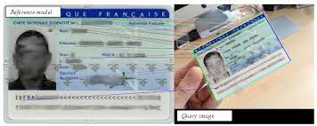
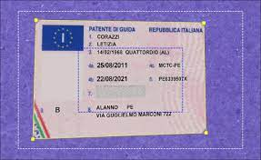
Different methods for id card localization
KEY POINTS EXTRACTION
CONTOUR AND CONTRAST
ADJUSTING VERTICES ITERATIVELY

Slide 7
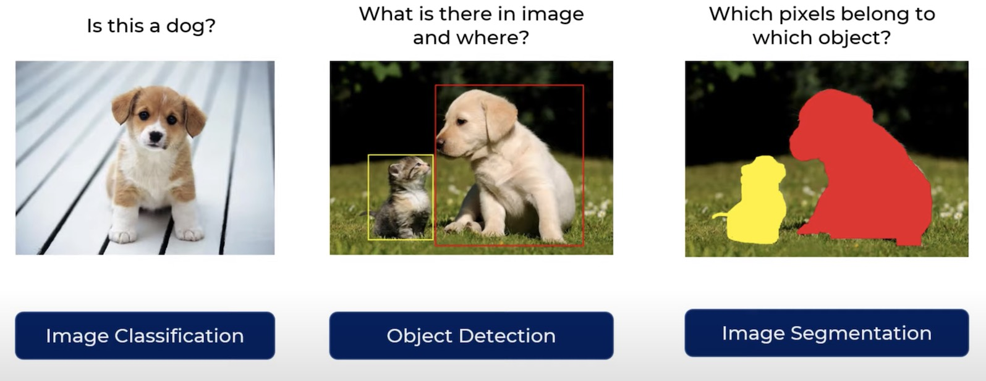
Semantic segmentation

Slide 8

UNet
Primarily developed for biomedical image segmentation
It can successfully perform semantic segmentation with scant amount of data

Slide 9

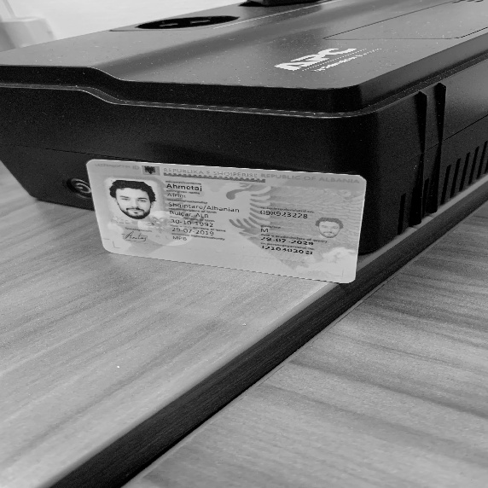

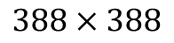
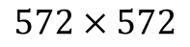
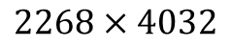
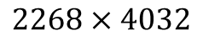
Query image and its expected output
UNET
$$572×572$$
$$388×388$$
$$2268×4032$$
$$2268×4032$$

Slide 10

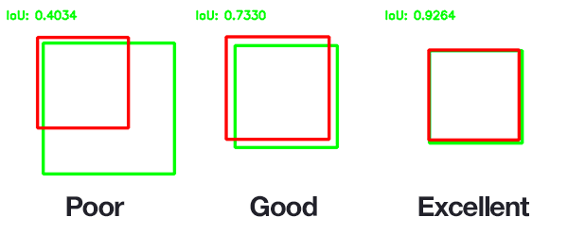
Intersection over union

Slide 11


Corner detection

Slide 12
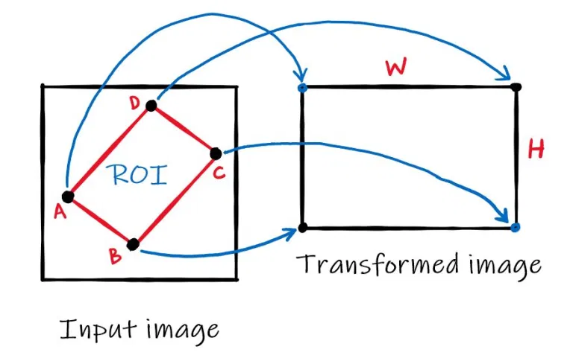
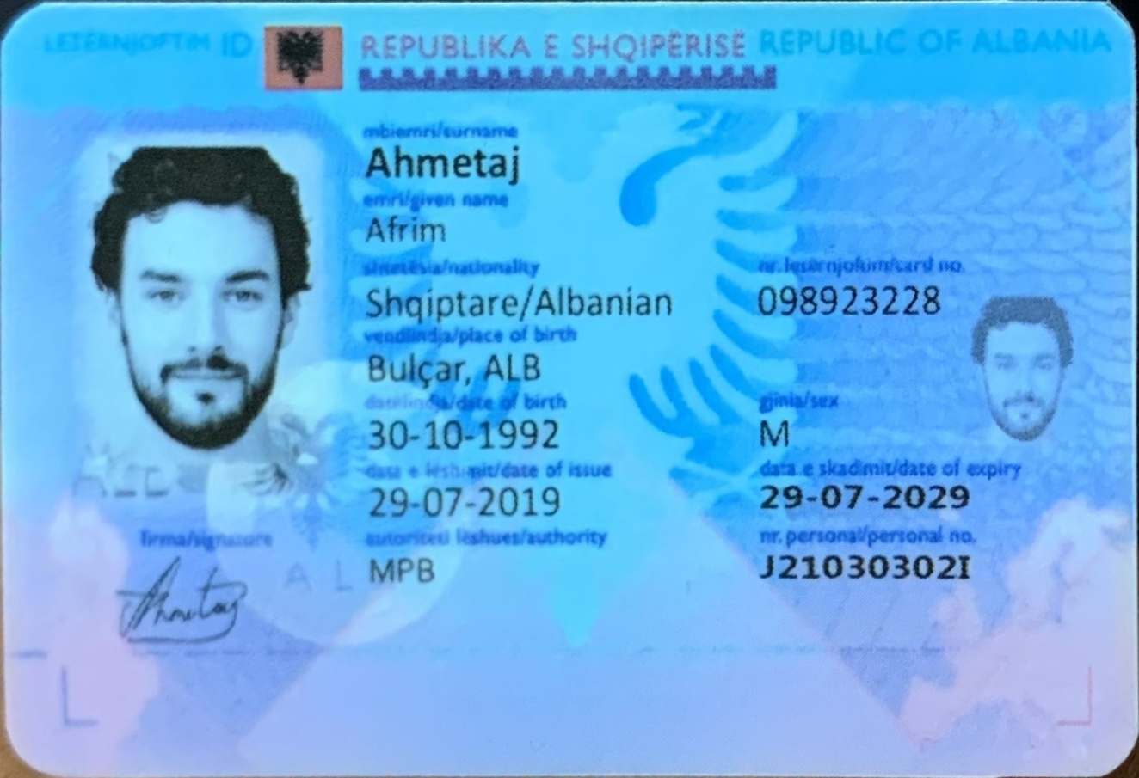
PERSPECTIVE TRANSFORMATION

Slide 13

Tesseract Ocr
An open source text recognition OCR Engine
Supports over 100 languages and has support for character and symbols

Slide 14
Sub-processes to perform ocr
Pre-processing the image
Text localization
Character segmentation
Character recognition
Post processing

Slide 15
Final results
LETËRNJOFTIM ID REPUBLIKA E SHQIPËRISË REPUBLIC OF ALBANIA mbiemri/surname Agani emery/given name Adnan shtetësia/nationality nr.letërnjoftim/card no. Shqiptare/Albanian 367253746 vendlindja/place of birth Bulçar/ALB datëlindja/date of birth gjinia/sex 20-11-1991 M data e lëshimit/date of issue data e skadimit/date of expiry 13-04-2019 13-04-2029 firma/signature autoriteti lëshues/authority nr.personal/ personal no. MB J11120296E

Slide 16
Required data
Surname | Agani
Given name | Adnan
Nationality | Albanian
Place of birth | Bulcar, ALB
Date of birth | 20-11-1991
Date of issue | 13-04-2019
Authority | MB
Card no. | 367253746
Sex | M
Date of expiry | 13-04-2029
Personal no. | J11120296E

Slide 17
Sources
Olaf Ronneberger, Philipp Fischer, and Thomas Brox. U-Net: Convolutional Networks for Biomedical Image Segmentation. https://arxiv.org/pdf/1505.04597.pdf
Alejandra Castelblanco, Jesus Solano, Christian Lopez, Esteban Rivera, Lizzy Tengana, Martín Ochoa. Machine Learning Techniques for Identity Document Verification in Uncontrolled Environments: A Case Study. https://link.springer.com/content/pdf/10.1007%2F978-3-030-49076-8_26.pdf
K.B. Bulatov, E.V. Emelianova, D.V. Tropin , N.S. Skoryukina , Y.S. Chernyshova , A.V. Sheshkus , S.A. Usilin , Z. Ming, J.-C. Burie , M. M. Luqman, V.V. Arlazarov 1,2MIDV-2020: A Comprehensive Benchmark Dataset for Identity Document Analysis https://arxiv.org/ftp/arxiv/papers/2107/2107.00396.pdf
Rodrigo Lara, Andres Valenzuela, Daniel Schulz, Juan Tapia and Christoph Busch. Towards an Efficient Semantic Segmentation Method of ID Cards for Verification Systems. https://arxiv.org/pdf/2111.12764.pdf

Slide 18
Thank you

